Slide 1
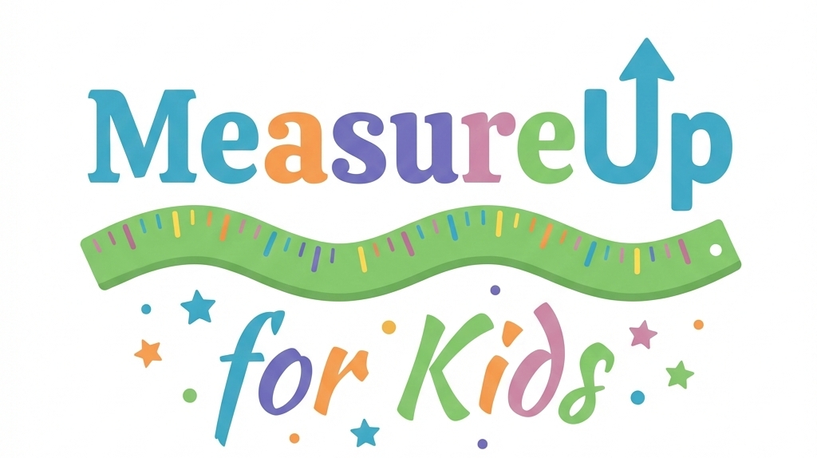
Create your impact pathways
Template
January 2026

Slide 2
Impact Pathways
What is an Impact Pathway?
An impact pathway is a visual descriptive diagram that shows the logical sequence from an organisation's activities through to the outcomes for the most affected people or stakeholders, and the ultimate social, environmental, or economic impacts.
Why do we need them?
Impact pathways make complex cause-and-effect relationships explicit and testable.
They help us to understand how our work leads from action to impact, to identify indicators of impact along the pathway, and to communicate how we create change clearly to our audiences.
Use in MeasureUp:
Impact pathways provide a tool for matching activities to the right values.
An impact pathway helps to show exactly where in the chain each value level fits—Bronze at the output/participation stage, Silver using demographic or engagement data, Gold linking to measured outcomes. This ensures values are applied conservatively and transparently, avoiding over-claiming.
For children and young people, mapping these pathways helps identify appropriate evidence and flags risks like double-counting overlapping values. They also support triangulation across qualitative (focus groups) and quantitative (surveys) data typical in children's programmes.

Slide 3
Create your impact pathways
Activity
Describes the specific intervention or service being delivered (for example, mentoring sessions, workshops, or volunteering).
Stakeholder/s
Identifies the people or groups who experience change as a result of the activity (such as young people, families, employers, or the wider community).
Clarifies why these stakeholders matter, including their role, needs, and how closely they are involved in or affected by the activity.
Outcome/s
Describes the meaningful changes the stakeholders experience because of the activity, such as improved wellbeing, skills, confidence, or environmental conditions.
Focuses on outcomes from the stakeholder’s perspective, making clear whether these changes are short-term, medium-term, or long-term along the impact pathway
MeasureUp value
Links each outcome to an evidence-based social value or wellbeing value from the MeasureUp framework, expressed in consistent monetary terms or WELLBY-style units.

Slide 4
How to use this template
Fill in the template sheet in the following page for each activity you want to estimate the social value of using appropriate MeasureUp values.
You can make a pathway for each different stakeholder group, and sub group, in your activity, or make a pathway at the whole activity level.
Examples of impact pathways for activities with children and young people can be found in the ‘MeasureUp for Kids: Test Case Examples Overview’ in the Children’s Wellbeing Toolkit.
Review the Children’s Wellbeing Toolkit values on the MeasureUp website here:

Slide 5
Activity
Stakeholder/s
Outcome/s
MeasureUp value
Description
Key details:
Location, frequency, duration, size,
Who is most affected…
Who is most invested…
For each stakeholder group what change/s do they experience?
Choose the MeasureUp values that best fit your activity / stakeholder / outcome

